Slide 1

Microsoft Word 2007 – Level 1
Chapter 3
FORMATTING PARAGRAPHS

Slide 2

Performance Objectives
Apply numbers and bullets to paragraphs
Insert paragraph borders and shading
Apply custom borders and shading
Sort paragraph text
Set, clear, and move tabs on the Ruler
and at the Tabs dialog box
Cut, copy, and paste text in a document
Copy and paste text between documents

Slide 3
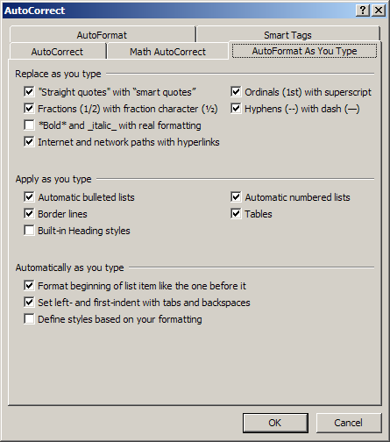
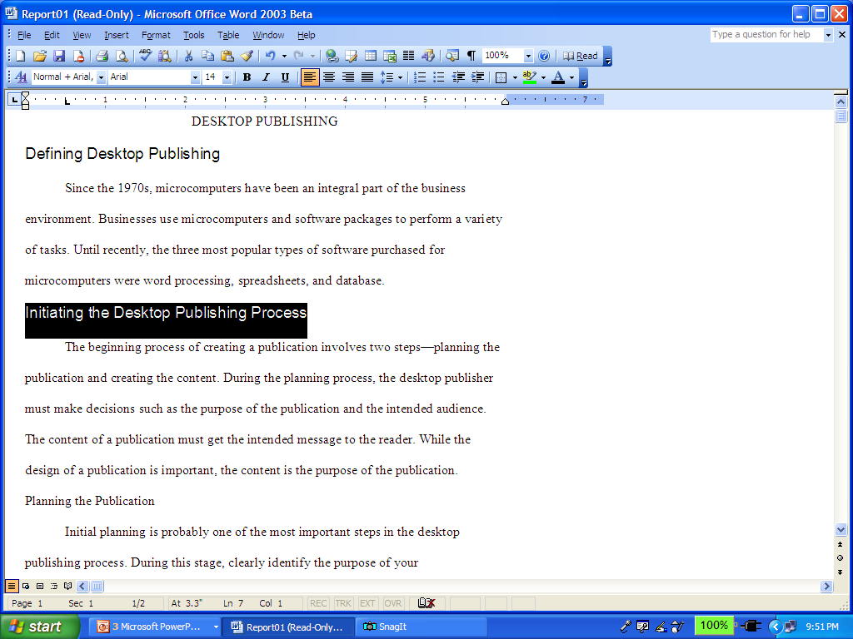
Apply Numbers and Bullets to Paragraphs
Using buttons…
Bullets
Numbering
AutoCorrect
Options
(can be turned off)

Slide 4
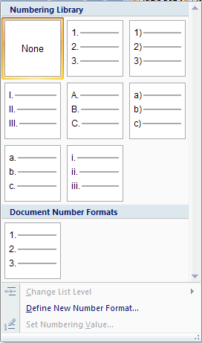
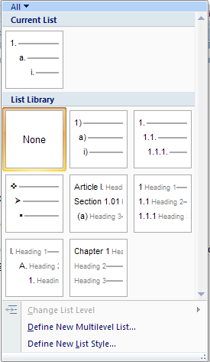
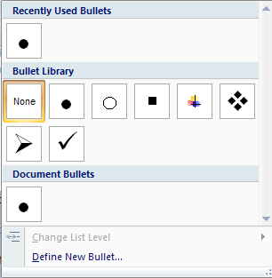
Using Bullets and Numbers
Multi-Level
Numbering
Bullets
Number
Styles

Slide 5
Border Concepts
every paragraph you create in Word
contains an invisible frame
the border can be added
to specific sides or to all sides
the type of border line and
thickness of the line can be
customized

Slide 6
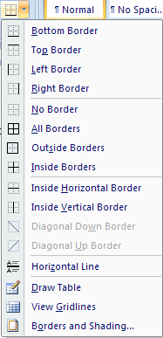
Inserting Paragraph Borders
click down-pointing arrow
click desired option
button changes
depending on
previous selection

Slide 7
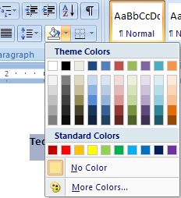
Adding Shading
Sets background color for selected text
click down-pointing arrow
click the desired color

Slide 8
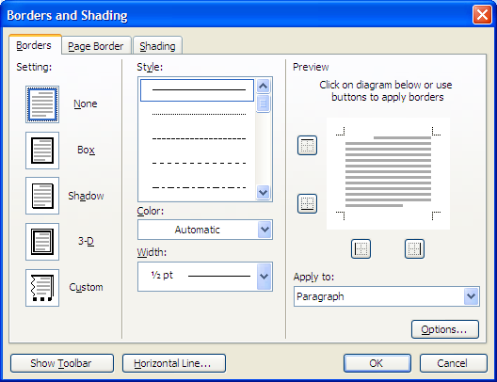
Customized Borders
click down-pointing arrow
.
.
.
select side(s)
with buttons
or by
clicking in
Preview
change
settings,
style,
color,
width
apply to…

Slide 9

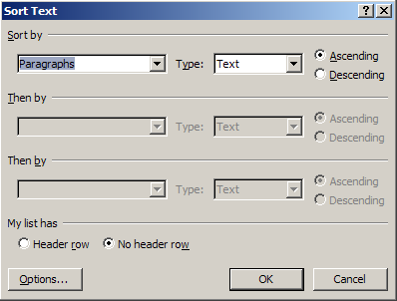
Sorting Text
click Sort button, make needed changes at Sort Text dialog box, click OK.

Slide 10
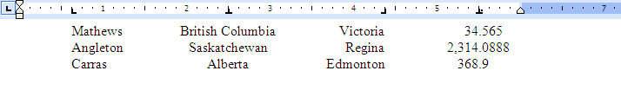
Types of Tabs
Left Tab
Center Tab
Right Tab
Decimal Tab
You can set the tabs before typing text, or
you can select existing text, and then set tabs.

Slide 11
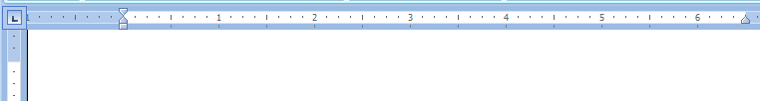
Manipulating Tabs on the Ruler
Turn on the display of the Ruler with
View, Ruler.
Tab Alignment
Symbols
Ruler
Alignment Button
Left Tab
Decimal Tab
Center Tab
Bar Tab
Right Tab

Slide 12
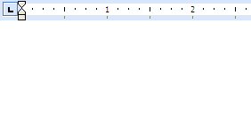
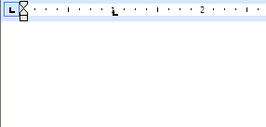
Setting Tabs
consecutively click Alignment button
to select the
desired tab type
click just below the tick
mark to put tab into place

Slide 13
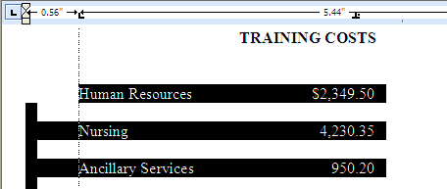
Setting Tabs at a Specific Measurement
Pointing to ruler while pressing Alt key
reveals actual measurements

Slide 14
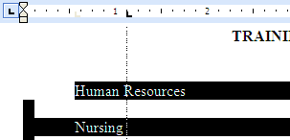
Moving and Deleting Tabs
Moving Tabs
line indicates
location on page
drag and drop the Tab with the mouse
Deleting Tabs
drag the Tab down into the document
screen with the mouse and release it

Slide 15
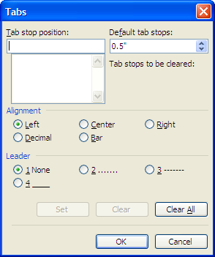
Setting Tabs at the Tabs Dialog Box
Paragraph Dialog Box button, Tabs …
type a tab
measurement
choose a tab
alignment
choose a leader
symbol
click to set

Slide 16
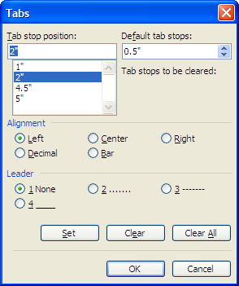
Clearing Tabs
Paragraph Dialog Box button,
Tabs …
click tab
click to delete
selected tab
click to delete
all tabs

Slide 17
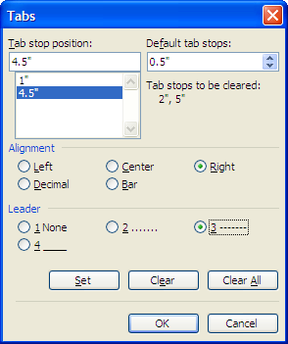

Setting Leader Tabs
useful when you want to direct the reader’s eyes across the page
select leader style

Slide 18
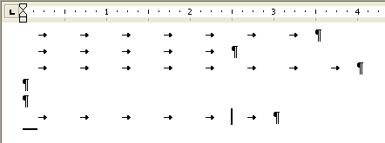
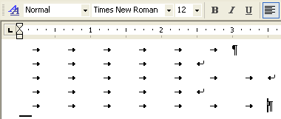
Inserting a Line Break
Turn on the display of nonprinting characters with the Show/Hide button.
Enter - creates a new paragraph
Shift + Enter - creates a new line
without creating a new paragraph

Slide 19

Cut / Copy / Paste
Four steps:
Select text to be copied or cut
Click Cut or Copy button
Position cursor at location to be inserted – within same document or other documents
Paste or Paste Special

Slide 20

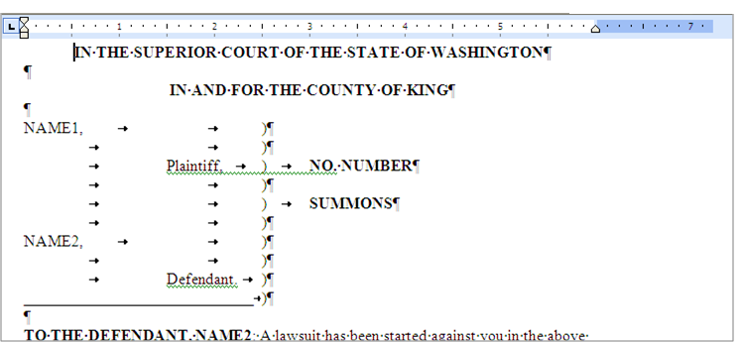
Features Summary
How do you display nonprinting characters?
Shift + Ctrl + *
OR
Show/Hide button

Slide 21
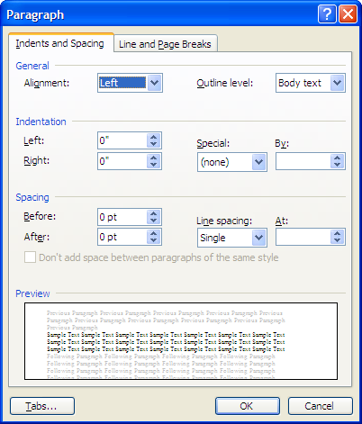
Features Summary
How do you display the Paragraph dialog box?
Lower right button in Paragraph group

Slide 22
Features Summary
How do you display the Borders and Shading dialog box?
Click Borders button arrow in Paragraph group
then click

Slide 23
Features Summary
How do you display the Ruler?
Turn on the display of the Ruler with
View, Ruler.

Slide 24
Features Summary
How do you use the New Line command?
Shift + Enter - creates a new line
without creating a new paragraph

Slide 25
Features Summary
How do you display the Tabs dialog box?
Paragraph dialog button, Tabs…

Slide 26
Coming Next
Chapter 4
FORMATTING PAGES

